Slide 1
Dealing with Discouragement as Newbie
Rachel Krantz
Stir Trek 2016
@rustbeltrachel

Slide 2
What I’m going to talk about
The fear of not belonging
How to make your learning work for you
Jobs: how to get them
Notes:
Slow down

Slide 3
How I got here
Teaching → Customer Service → Sales → Recruiting → Marketing → Tech
HTMLGoodies.com → Coursera
Pittsburgh → Akron → Akron Women in Tech → VHT
Notes:
Slow down
No matter your background, you have transferrable skills

Slide 4
A bit about me
I speak without thinking
I embrace the awkward
Dichotomy
Notes:
Slow down
Dichotomy – “am I smart enough?” + fear of being found out | versus | I know I am intelligent and flippin’ awesome

Slide 5
The fear of not belonging
Notes:
Recognize it
Embrace it
Face it

Slide 6
Recognize it
Notes:
Slow down
Example of my first ACC meetup.
If you run events like that and you notice a new person, reach out after the event. Especially if they have the deer-in-headlights look!
What situations scare you? Are you “scared of getting found out”? Worried you won’t be able to keep up? Believe you don’t know enough to learn something?
Why do you have that fear? What causes it, and what can you do to recognize the fallacies in it?

Slide 7
Embrace it
Code Newbies & FreeCodeCamp
I know things other people don’t
I don’t know things other people also don’t know
Be OK with not knowing the right answer
Always be improving
Notes:
Slow down
Code Newbies & FreeCodeCamp – very open and welcoming for Q&A
Explain what they are
Right answers – Jerry and Brian katas – explain what katas are
Improving: you should be able to recognize code you wrote months or years ago is bad, compared to what you know now. “If you are improving, you are doing fine and don't let anyone tell you otherwise.” - Jeff

Slide 8
Face it
Notes:
Slow down
“If you stay in your comfort zone, you don’t learn, because you’re not stretching.” - Katrina Owen, Ruby Rogues
Volunteered for awit talks of growing hardness levels, then I opened my mouth and volunteered for a thing at the ClePy meetup
You want the sweet spot between comfort and the ‘stress zone’
What is your level of “facing it”?
Showing up to a meetup?
Giving a talk?
Asking for help?
Offering help?
Figure it out, then do that
Like learning a new skill – you practice what you’re not good at, and you get good at it. Same goes for facing fear
You want 1 or 2 levels above where you are, not 10 levels. Stretches you, not breaks you
Things that terrify me: katas, volunteering for ClePy talk, xDD, lunchtime programming practice. So I do them.

Slide 9
You’re not that unique
Notes:
Slow down
There’s a term for someone who feels like they “don’t deserve to be here” – Imposter Syndrome: “those exhibiting the syndrome remain convinced that they are frauds and do not deserve the success they have achieved”

Slide 10

Notes:
Slow down
It’s easy to get into a habit of poking fun at your skills and how much you don’t know.
Accept the fact that you feel out of place. It’s OK. Most people face this at some point in their lives. Accept your shortcomings and own them. If someone feels the need to point them out, you can agree and move on and not waste time feeling slighted.
Remember that where you are now isn’t the same as where you are going. Always be improving.

Slide 11
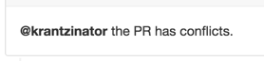
Yes, you will run into difficult people
Notes:
Slow down
- First comment did not ask me to fix anything, it was merely derogatory
Second comment was entirely unhelpful, and a slightly ignorant comment
It happens. Make sure you have people around you to support you when it does.

Slide 12
How to learn
Notes:
Slow down

Slide 13
Get really good at one thing
Notes:
Slow down
One or two languages at a time
“For loop” struggles

Slide 14
Badges != Understanding
Notes:
Slow down
“The problem with valuing the outcome is you start looking for shortcuts to get to the outcome. It’s like the opposite of talent. You end up hoping you’re just going to walk on the field and be great. And if you’re not great, you have no tools in your belt to deal with it.” - Ruby Rogues podcast

Slide 15
Combine Mediums
Notes:
Slow down
My lightbulb moments in learning JavaScript came from combining FCC with Jon Duckett’s ‘JavaScript & jQuery’ book

Slide 16
Be careful of burnout
Notes:
Slow down
Don’t be afraid to take a step back. Remember, 1-2 steps outside of your comfort zone. Not 5; not 3. This is for you to know and recognize what your limits are.
What workload makes you most effective?

Slide 17
Have a purpose
Notes:
Slow down
I was fairly direction-less until Kevin challenged me to learn enough to charge $25/hour for freelance WordPress work. I never got there – I don’t want to get there – but it was the push I needed to hone in on specific skills, which prepared me for my job hunt that was only 6 months away, unbeknownst to me

Slide 18
Stop searching for your passion | Terri Trespicio
Notes:
Slow down
Pick a thing, get good at it, and it will become your passion
Stop waffling over what’s the ‘best’ language to learn, the ‘hottest’ framework to be using. PICK SOMETHING, then get really, really good at it.

Slide 19
N O P S
otice it wn it ush into it tick with it
Notes:
Slow down NOPS: Notice it, Own it, Push into it, Stay with it
anytime you’re aware of discomfort while you’re learning something, notice it and own it
Push into it: if you can’t wrap your head around X, sit down and write that line of code until you get comfortable with it

Slide 20
Jobs: how to get them
How I found VHT
Interview nerves
Notes:
Slow down
How I found VHT
They hired people from the Guild
Knew Heather through AWiT, other VHT employees at other meetups
They were invested in the community – AWiT & ACC
Look for companies, not jobs
Interviewing
I don’t get nervous for interviews. I was hellanervous for VHT’s interview. I WANTED this, &I didn’t believe I was knowledgeable enough
Live coding is nervewracking. The only way around this is practice.
Remember, it’s about how you think and reason through the problem more than the solution you create. (related to: don’t get caught up on knowing the ”right” answer)
“It is much easier to change a candidate's coding practices than their thought process or ability to solve complex problems.” - Jeff

Slide 21
Negotiate
Do it
“They are paying you for a job.”
How much is your effort worth?
Notes:
Slow down
Dealing with the feeling that you’re lucky to have a job as a beginner. Push past that. They want to hire you! They’re not lying!

Slide 22
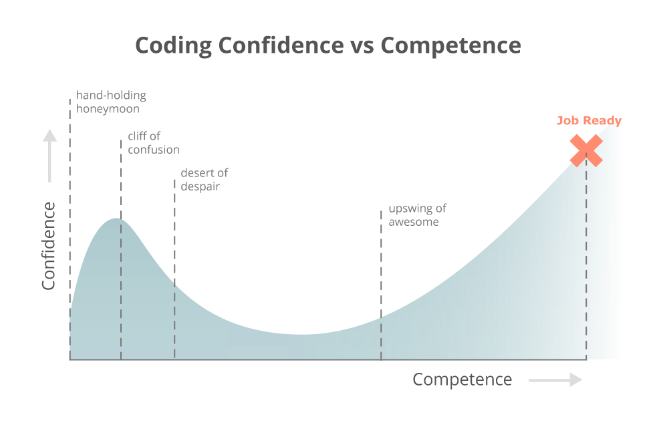
Notes:
Slow down
Rather than asking “What do I do,” I try to ask “I’m having this problem, these are the ways I can think of that might solve it. How do I got about finding the information I need to tackle this?”

Slide 23
In conclusion
Find your awesome
Stretch yourself, but don’t break
Focus in on what you want, then go after it
Notes:
FCC (newbie) developer survey: 57% have never attended an in-person coding event (aka meetup, RailsBridge, etc)

Slide 24
Resources
FreeCodeCamp
Code Newbies
How to Learn – Ruby Rogues (podcast)
Stop Searching for Your Passion – Terri Trespicio (TEDTalks)
FreeCodeCamp’s newbie developer survey (Medium)
Learn to code like a Korean student learns English (Medium)
Twitter: @rustbeltrachel – I’m real friendly

